Slide 1
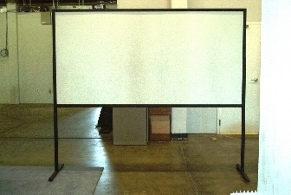
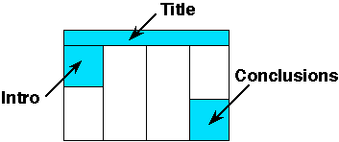
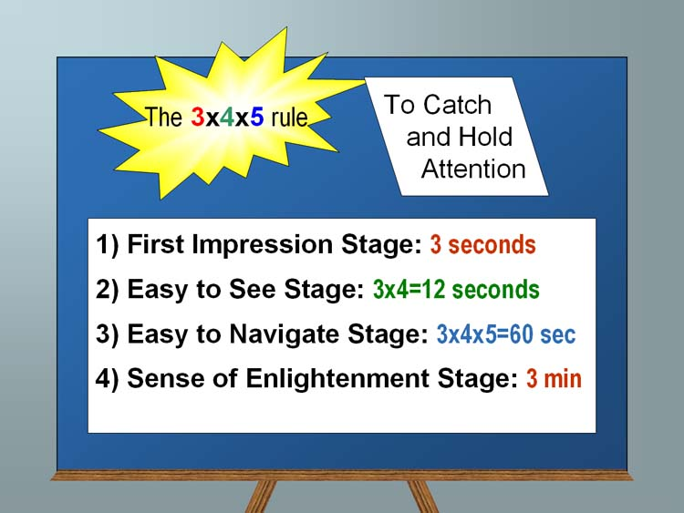
Bridging cognitive, statistical, and neural descriptions of multi-agent bird foraging behavior
(First names of authors increase interaction potential)
School Logo here
Section 1 (sizes):
Posters boards are 48” tall and 96” wide, but we recommend you leave a little border since you may not be able to pin at the vertical edge. Since PowerPoint does not let one define such a large paper size, this template is designed to be printed at 200%, yielding a 46” x94” poster. You can scale it up or down a bit (e.g. 42” is a common paper size at FexEd). Note there is no direct international A0.. A1 equivalent. The poster size is approximately three A0 boards next to each other, i.e., each column in this example is about one A0 board.
Ideally you want to keep it very readable: this is not your paper, it is a poster. 32pt here (64 final printing) is good for most text:
Sub-bullets are 28 here (56 final)
Don’t use smaller than 24pt in this template (which is 48pt in final printing at 200%)
Insert plenty of graphics and any math you need
When inserting graphics or equations, keep the resolution high (remember this will be printed at 200%). If you can see blocking artifacts at 400% magnification in PowerPoint, consider finding better graphics. This is an example of BAD/LOW RES GRAPHICS
Leave enough margin for pushpin and remember many big plotters cannot get within .5” of the actual paper edge.
You are free to use colored backgrounds and such but they generally reduce readability.
You are free to use what ever fonts you like.
San Serif fonts like Arial are more readable from a distance,
Serif fonts like times may look more consistent with your mathematics
Section 2 (layout):
Remember the poster session will be crowded so design the poster to be read in columns so people can read what is in front of them and move left to right to get the whole story.
The poster should use photos, figures, and tables to tell the story of the study. For clarity, present the information in a sequence that is easy to follow.
There is often way too much text in a poster - there definitely is in this template! Posters primarily are visual presentations; the text should support the graphics. Look critically at the layout. Some poster 'experts' suggest that if there is about 20-25% text, 40-45% graphics and 30-40% empty space, you are doing well.
Section 3:
Include more figures than are in the paper so you can talk to them. Include things that are not in the paper and then encourage them to read the paper. Don’t try to just put all the paper here.
If it looks like a cut/paste of the paper, people skip that poster since they can read the papers after the conference. Many people find it better to spend time talking with poster presenters that have more to offer than just redoing the paper content paper in big fonts.
People will likely have already seen your posted video, so the poster can serve as a talking point for you.
Remember Poster boards look like this.. This is your canvas. Paint us a picture of your work.
Summary/Conclusion
Summarize your contributions
Summarize your results (if applicable)
You an add in links to additional videos, code, or project website (or QR code)
References
Notes:
1

Slide 2
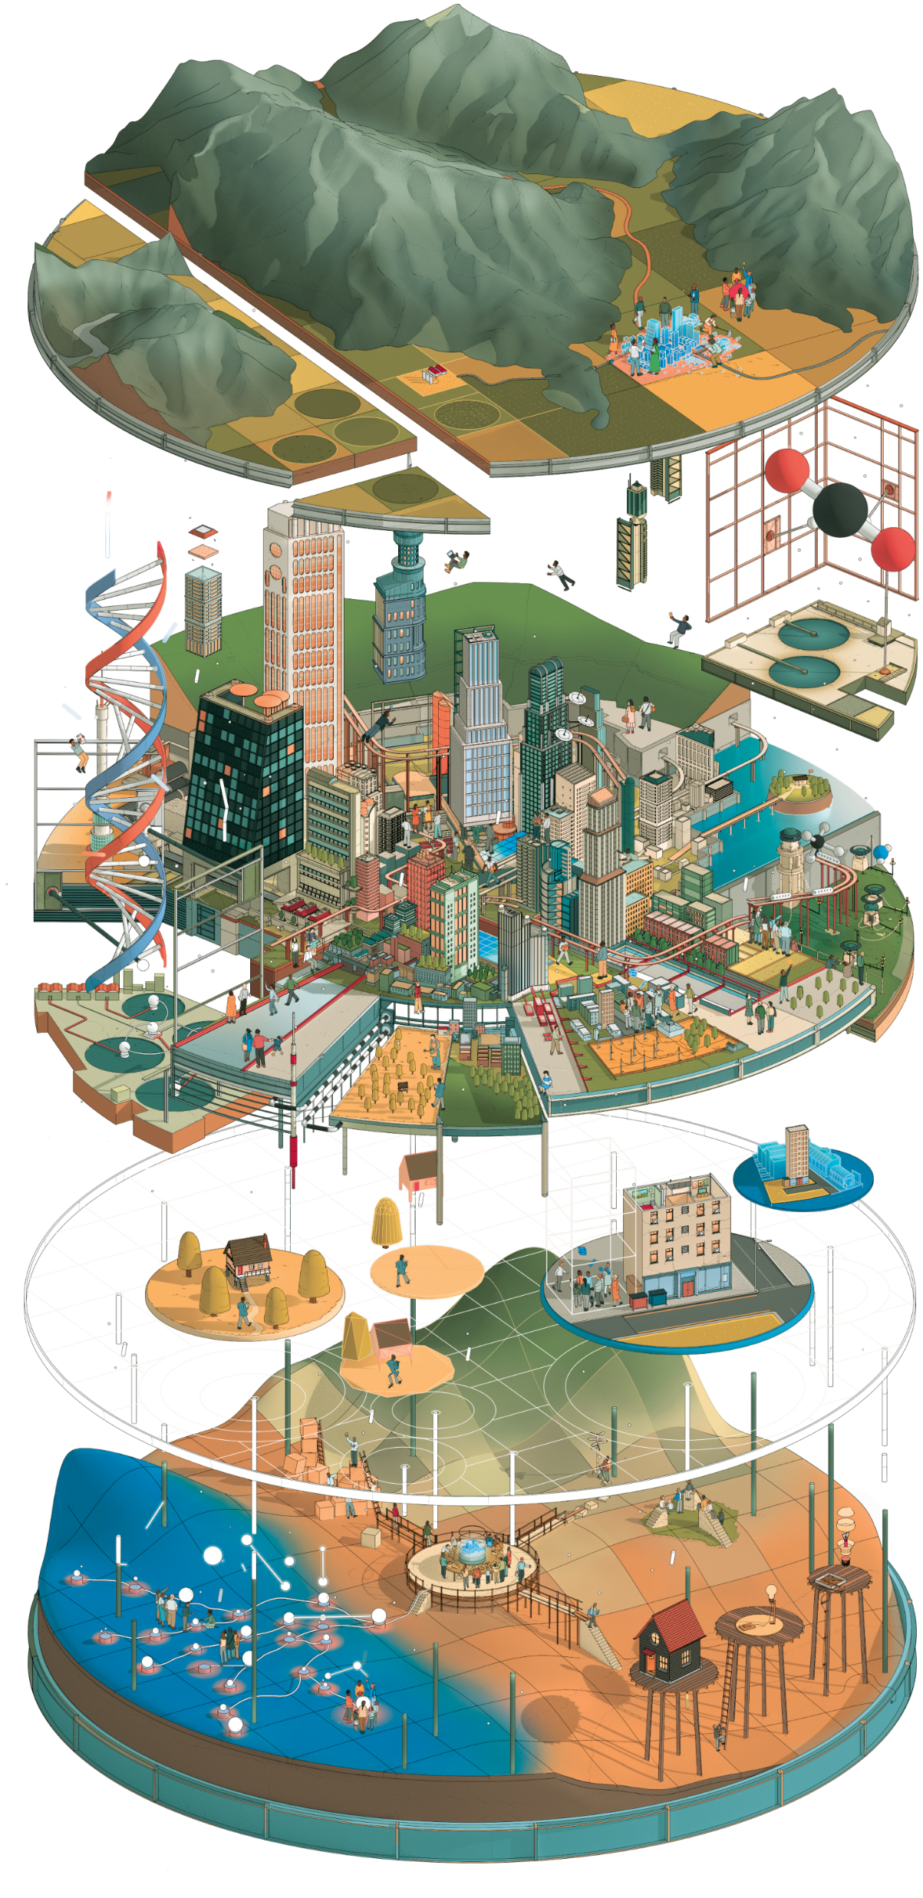
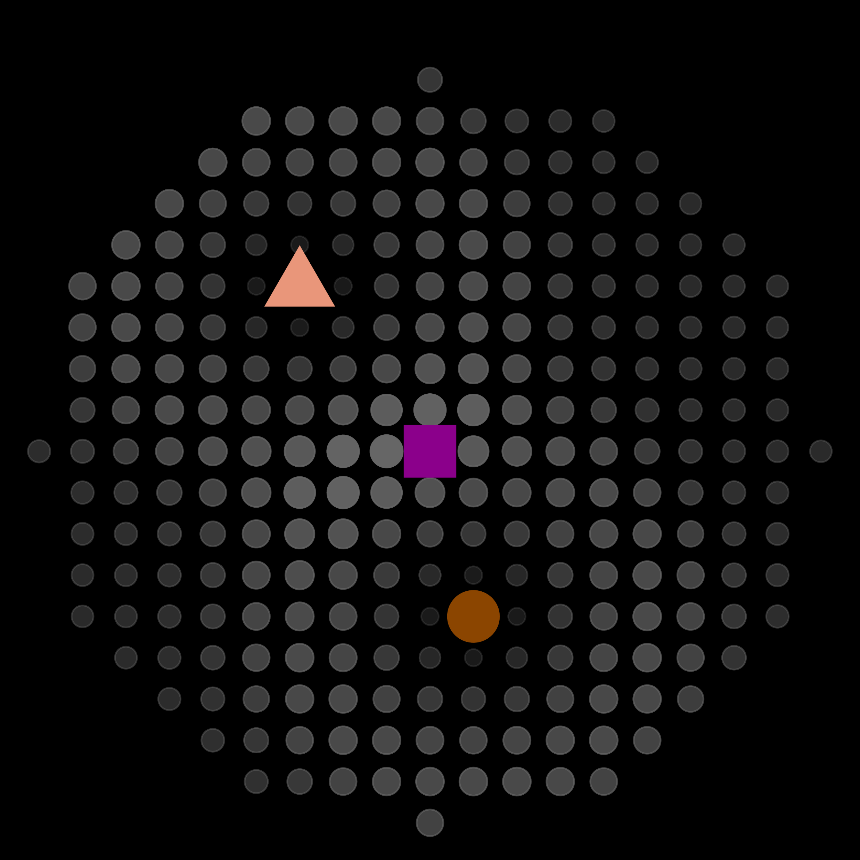
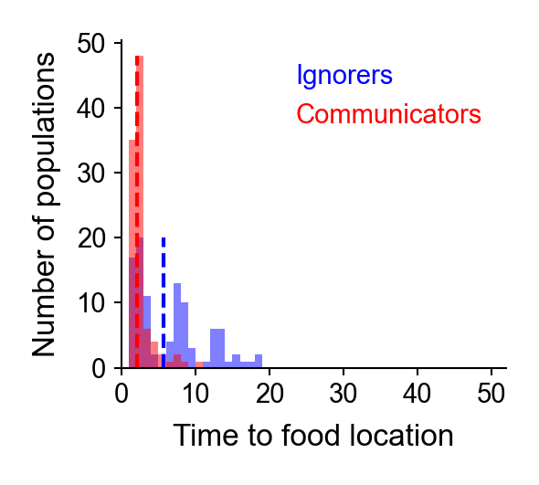
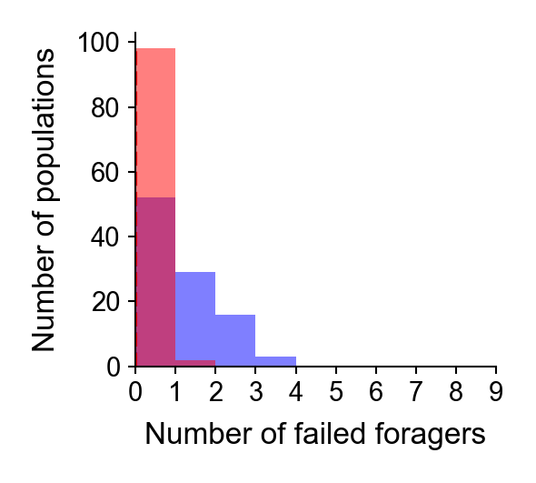
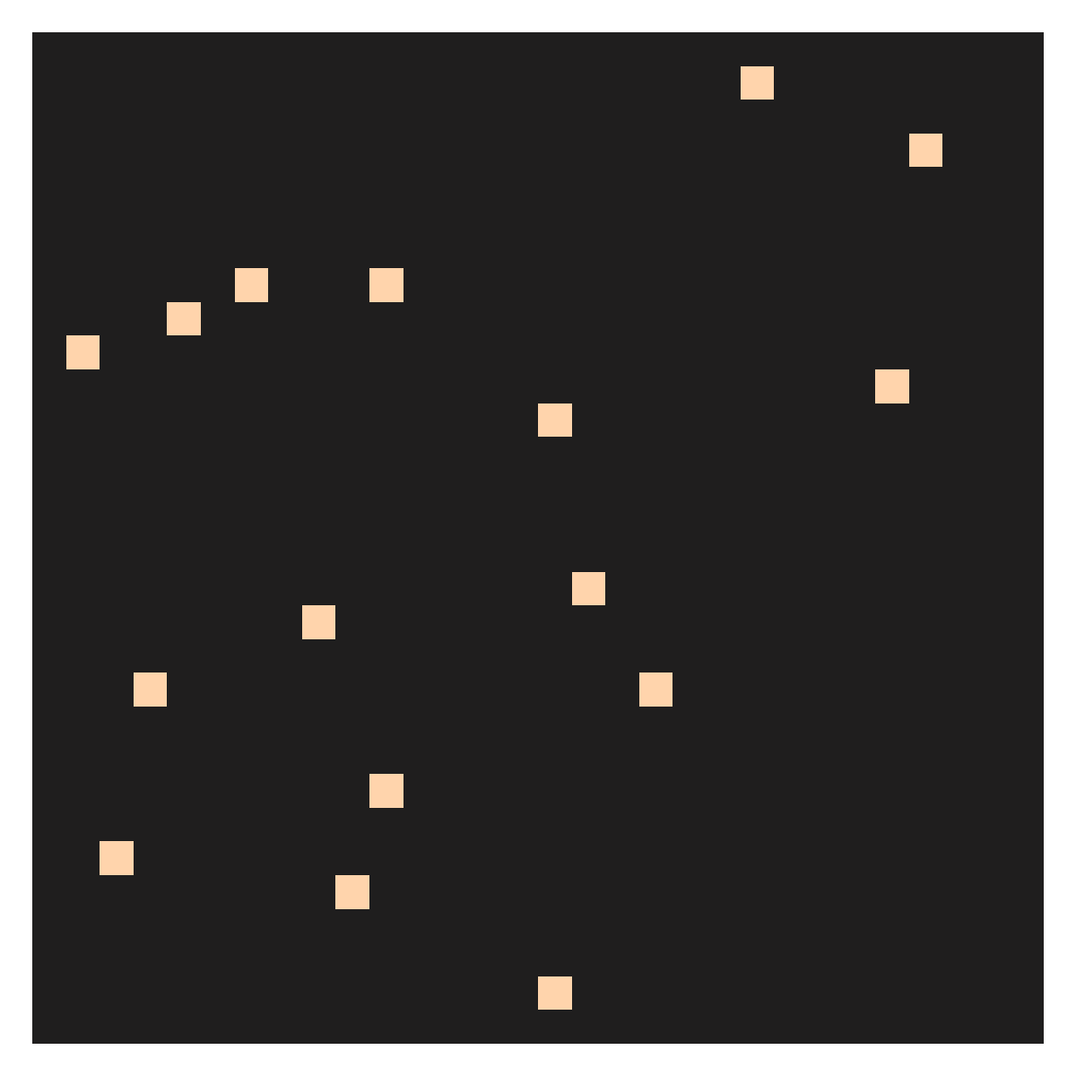
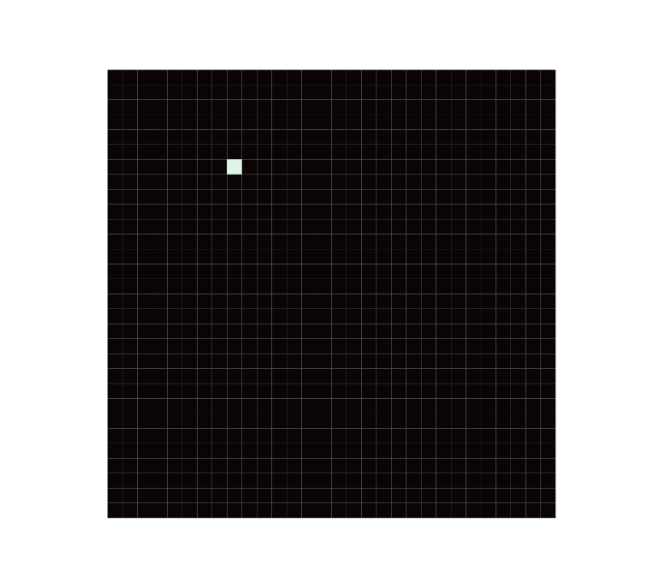
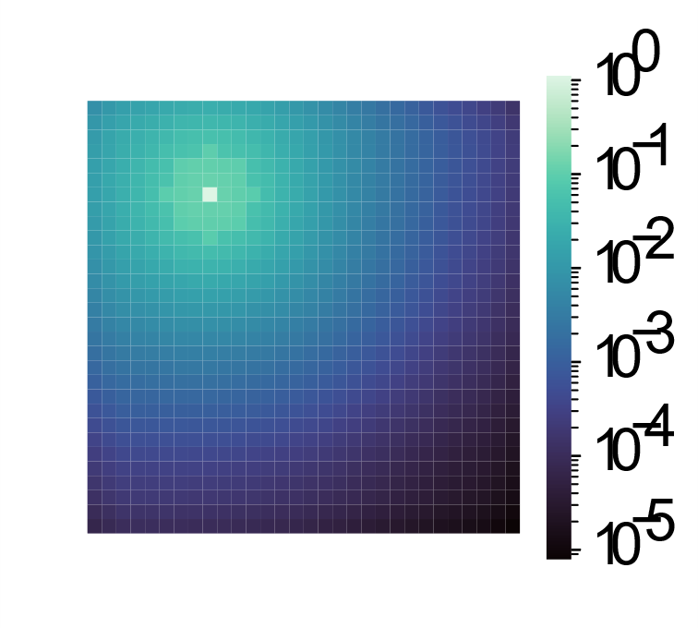
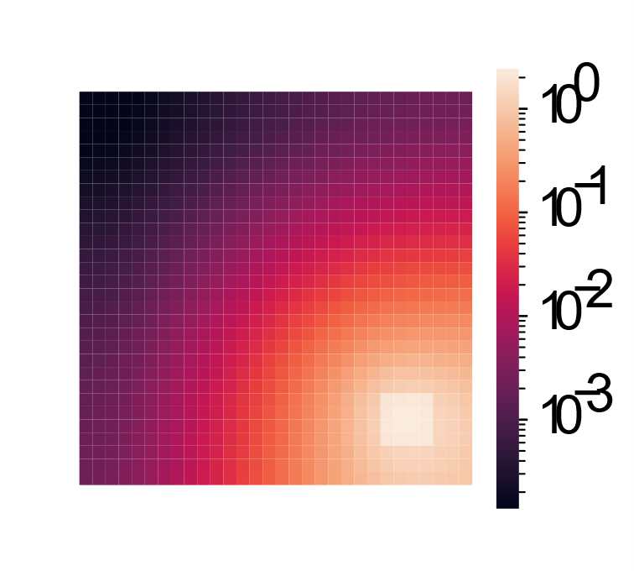

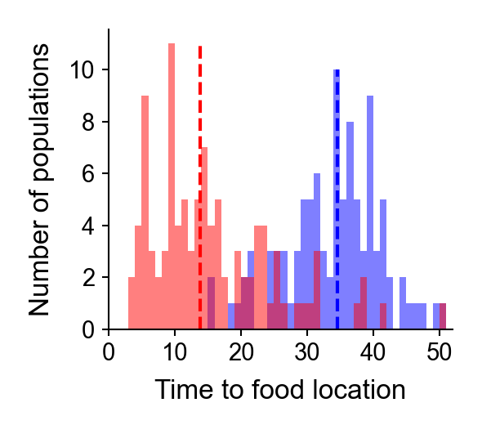
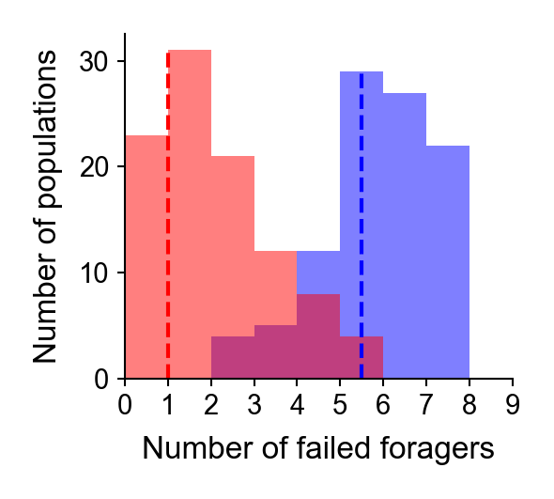
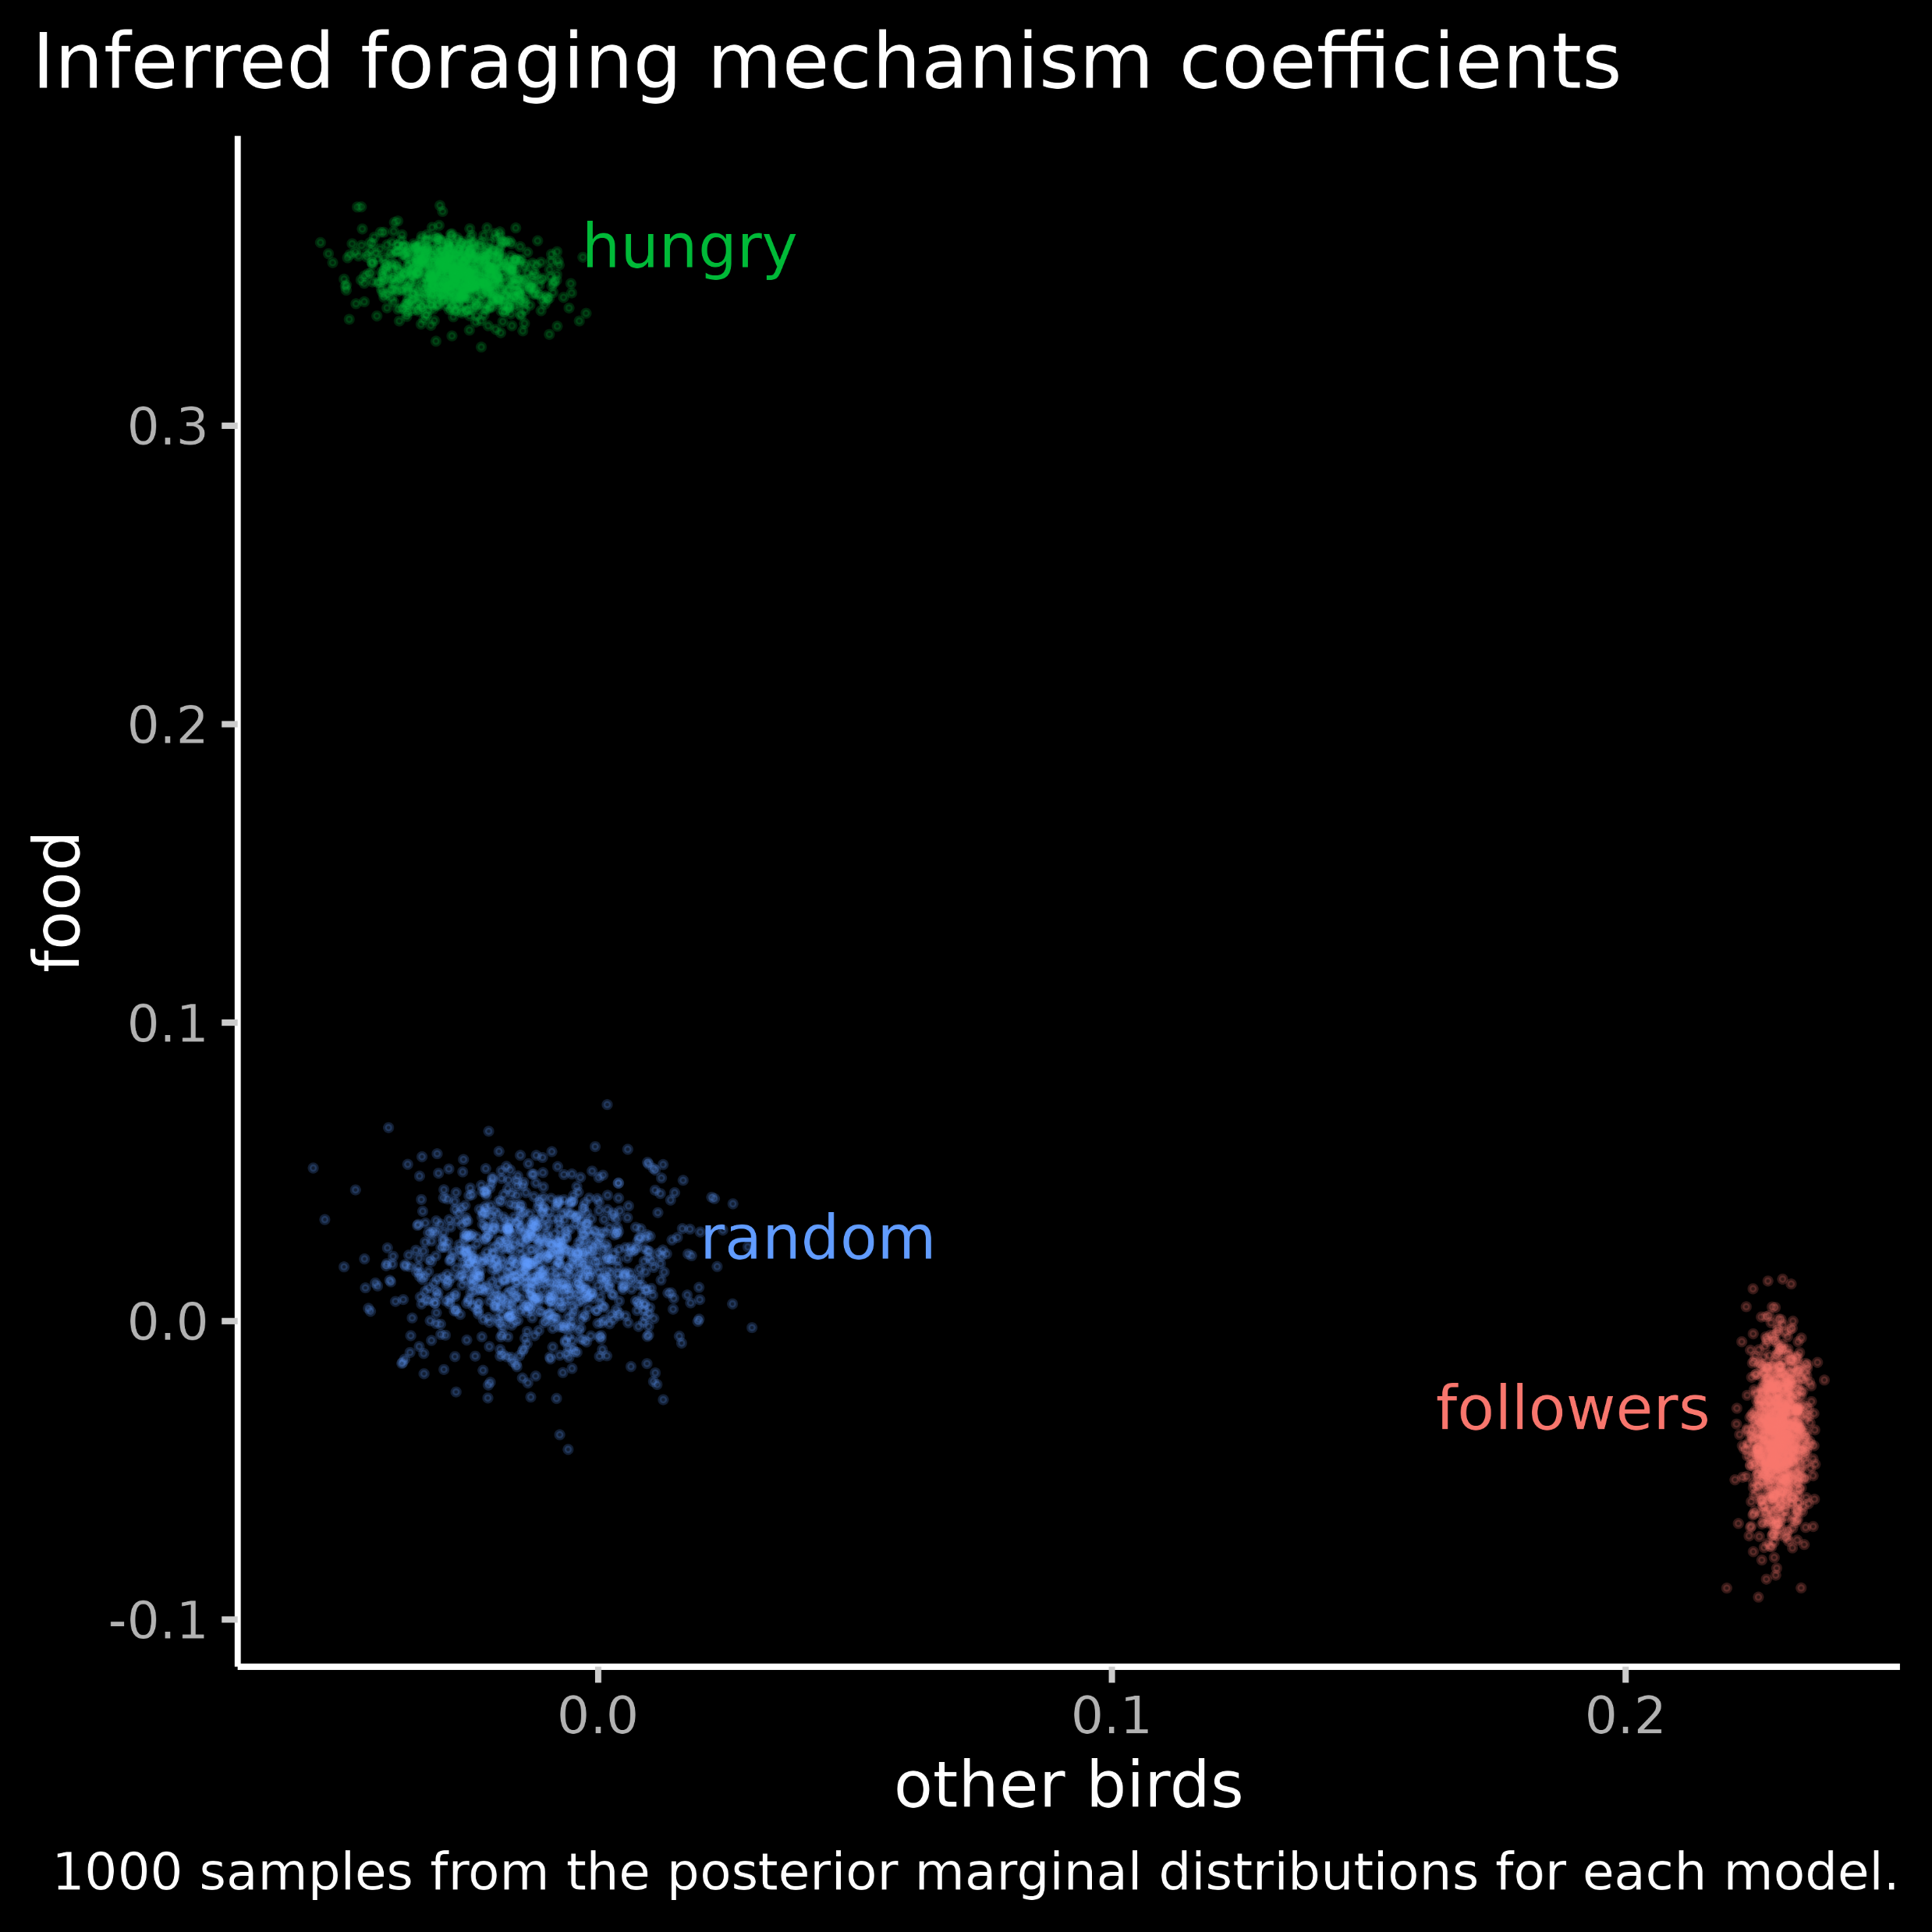
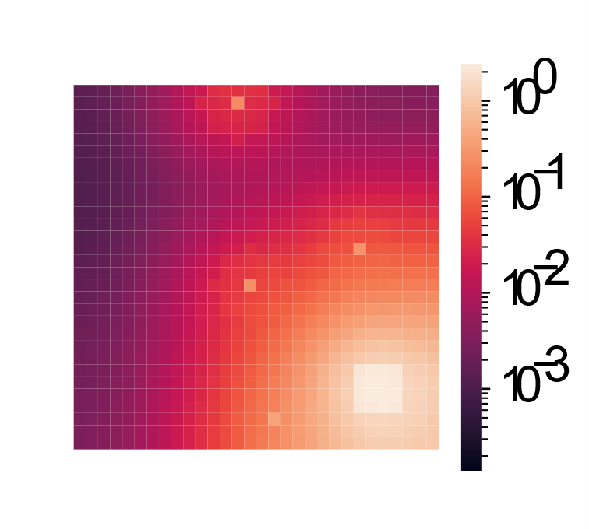
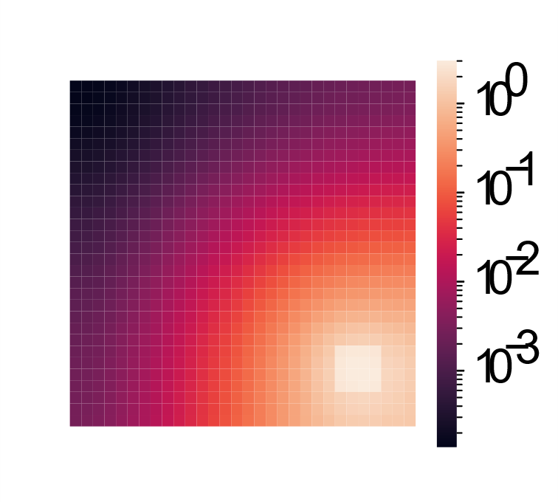
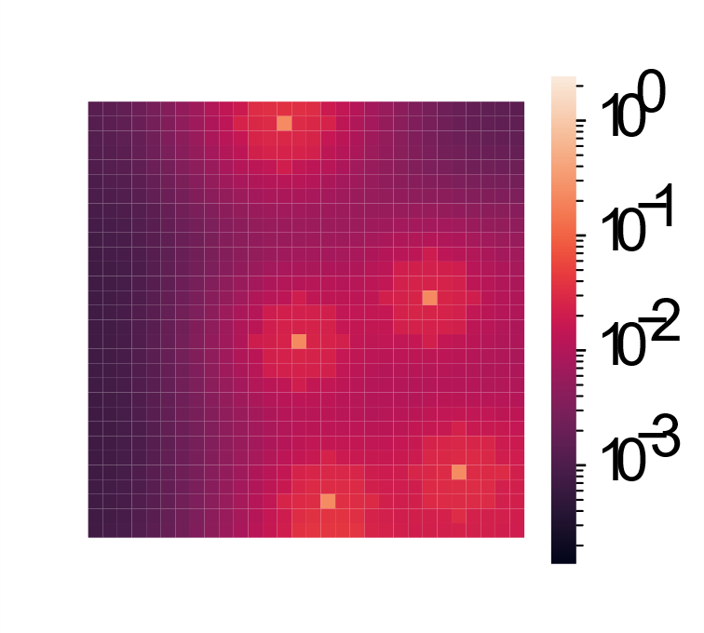

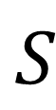
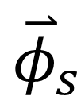
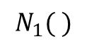

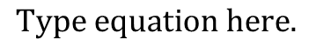
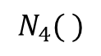
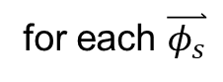

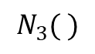
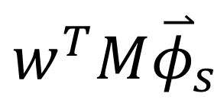
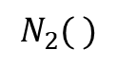

Bridging cognitive, statistical, and neural descriptions of multi-agent bird foraging behavior
(First names of authors increase interaction potential)
Why care about bird foraging – we focus on communication
Cognitive, neural, and statistical descriptions of decision-making
Statistical inference
Toward an understanding mechanisms of communication in multi-agent bird flocks
State
State
(perceived)
Predictive SR representation
Value
Action
Communicators reach food rewards faster than ignorers.
Fewer communicators fail to find food than ignorers.
$$S_{ }$$
$$N_{1}( )$$
$${\overset{⃑}{φ}}_{s}$$
$$N_{2}( )$$
$${M\overset{⃑}{φ}}_{s}$$
$$N_{3}( )$$
$${w^{T}M\overset{⃑}{φ}}_{s}$$
$$N_{4}( )$$
$$A^{cog}$$
Distributed food
for each $\overset{⃑}{φ_{s}}$
$$M=Σ_{t=0}^{∞} {\left(γJ\right)}^{t}$$
Benefit of communication as a strategy is more pronounced in clustered food environments.
Three different goals, descriptions, and citations (table)
Temporal discount factor
State transition matrix
Clustered food
Neural network diagram
Inference questions for future work:
To what extent do the birds value information about rewards from other birds versus from their own experience?
Under certain conditions, the most likely action is given by
Field work
$$A_{s}=argmax_{A} P\left(A | S\right)=A^{cog}=A^{neuro}$$
Translating between cognitive, neural, and statistical descriptions
“How much the bird values food”
“How much the bird values other birds”
“To what extent location of food predicts this bird’s behavior”
“To what extent locations of other birds predict this birds’ behavior”
Notes:
2

